Slide 1
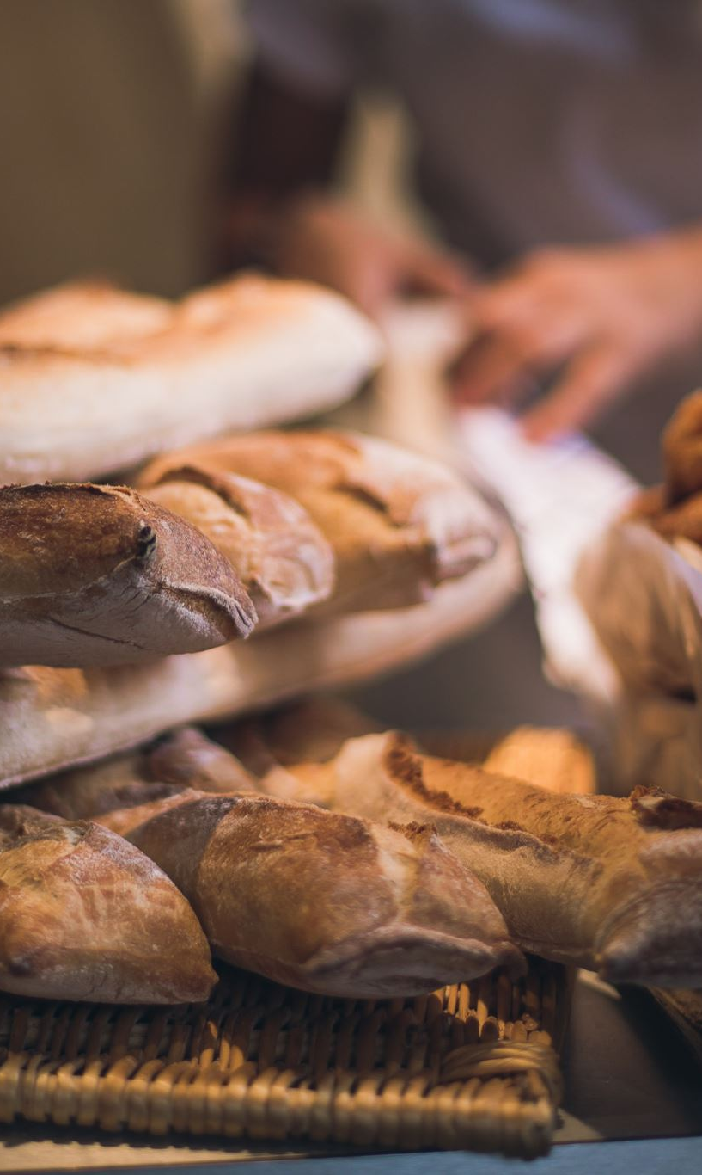
Predicting diabetic risK
Modeling fasting blood glucose level from dietary data
SiegFried LeunG

Slide 2
How do we diagnose Type II diabetes?
Checking fasting blood glucose or A1c by blood test

Slide 3
How do we virtual screen?
Concept:
As a first pass, can we predict those with high fasting blood glucose?
Can we do so from one’s diet?
Goal:
Develop a predictive classification model for fasting blood glucose from dietary data
This can be a non-invasive tool to help alert those affected to follow up with physicians
Or help doctors identify potential diabetes patients early on

Slide 4

Data for this study
Organized data set on Kaggle:
https://www.cdc.gov/nchs/nhanes/index.htm
The National Health and Nutrition Examination Survey (NHANES) is a program of studies designed to assess the health and nutritional status of adults and children in the United States.
The survey is unique in that it combines interviews and physical examinations:
The interview includes demographic, socioeconomic, dietary, and health-related questions
The examination component consists of medical, dental, and physiological measurements, as well as laboratory tests
The survey examines a nationally representative sample of about 5,000 persons each year.
NHANES is a major program of the National Center for Health Statistics (NCHS). NCHS is part of the Centers for Disease Control and Prevention (CDC) and is responsible for producing vital and health statistics for the nation
https://www.cdc.gov/nchs/nhanes/index.htm

Slide 5
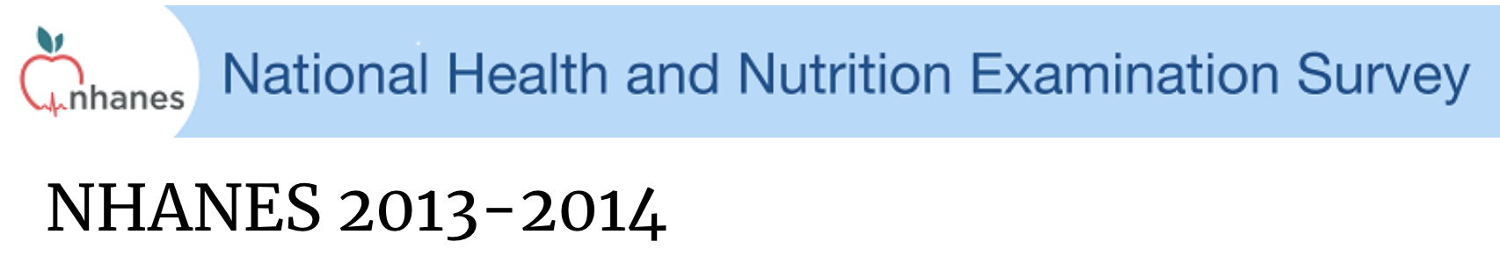
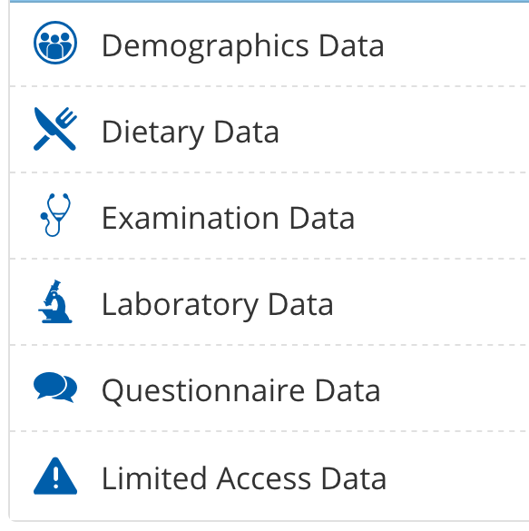
Data for this study
Basic demographic data
(Age and gender)
Dietary and nutrient information from the dietary survey
Types and amounts of food and drinks consumed in the 24-hour period before the interview, and the corresponding energy intake, nutrients and other food components
Diet-related habits, such as salt use in food preparation.
Laboratory measurements of fasting blood glucose
Official: https://wwwn.cdc.gov/nchs/nhanes/ContinuousNhanes/Default.aspx?BeginYear=2013
Kaggle (organized): https://www.kaggle.com/cdc/national-health-and-nutrition-examination-survey

Slide 6
Selected data (1/2)
Data group | Data label | Description | Variable type
Lab | LBXGLU | Fasting Glucose (mg/dL) | Numerical
Diet | DR1TKCAL | Energy (kcal) | Numerical
Diet | DR1TPROT | Protein (gm) | Numerical
Diet | DR1TCARB | Carbohydrate (gm) | Numerical
Diet | DR1TSUGR | Total sugars (gm) | Numerical
Diet | DR1TFIBE | Dietary fiber (gm) | Numerical
Diet | DR1TTFAT | Total fat (gm) | Numerical
Diet | DR1TSFAT | Total saturated fatty acids (gm) | Numerical
Diet | DR1TMFAT | Total monounsaturated fatty acids (gm) | Numerical
Diet | DR1TPFAT | Total polyunsaturated fatty acids (gm) | Numerical
Diet | DR1TCHOL | Cholesterol (mg) | Numerical
Diet | DR1TATOC | Vitamin E as alpha-tocopherol (mg) | Numerical
Diet | DR1TATOA | Added alpha-tocopherol Vitamin E (mg) | Numerical
Diet | DR1TRET | Retinol (mcg) | Numerical
Diet | DR1TVARA | Vitamin A - RAE (mcg) | Numerical
Diet | DR1TACAR | Alpha-carotene (mcg) | Numerical
Diet | DR1TBCAR | Beta-carotene (mcg) | Numerical
Diet | DR1TCRYP | Beta-cryptoxanthin (mcg) | Numerical
Diet | DR1TLYCO | Lycopene (mcg) | Numerical
Diet | DR1TLZ | Lutein + zeaxanthin (mcg) | Numerical
Diet | DR1TVB1 | Thiamin Vitamin B1 (mg) | Numerical
Diet | DR1TVB2 | Riboflavin Vitamin B2 (mg) | Numerical
Diet | DR1TNIAC | Niacin (mg) | Numerical
Diet | DR1TVB6 | Vitamin B6 (mg) | Numerical
Diet | DR1TFOLA | Total folate (mcg) | Numerical
Diet | DR1TFA | Folic acid (mcg) | Numerical
Diet | DR1TFF | Food folate (mcg) | Numerical
Diet | DR1TFDFE | Folate DFE (mcg) | Numerical
Diet | DR1TCHL | Total choline (mg) | Numerical

Slide 7
Selected data (2/2)
Data group | Data label | Description | Variable type
Diet | DR1TB12A | Added vitamin B12 (mcg) | Numerical
Diet | DR1TVC | Vitamin C (mg) | Numerical
Diet | DR1TVD | Vitamin D - D2 + D3 (mcg) | Numerical
Diet | DR1TVK | Vitamin K (mcg) | Numerical
Diet | DR1TCALC | Calcium (mg) | Numerical
Diet | DR1TPHOS | Phosphorus (mg) | Numerical
Diet | DR1TMAGN | Magnesium (mg) | Numerical
Diet | DR1TIRON | Iron (mg) | Numerical
Diet | DR1TZINC | Zinc (mg) | Numerical
Diet | DR1TCOPP | Copper (mg) | Numerical
Diet | DR1TSODI | Sodium (mg) | Numerical
Diet | DR1TPOTA | Potassium (mg) | Numerical
Diet | DR1TSELE | Selenium (mcg) | Numerical
Diet | DR1TCAFF | Caffeine (mg) | Numerical
Diet | DR1TTHEO | Theobromine (mg) | Numerical
Diet | DR1TALCO | Alcohol (gm) | Numerical
Diet | DR1TMOIS | Moisture (gm) | Numerical
Diet | DR1BWATZ | Total bottled water drank yesterday (gm) | Numerical
Diet | DBQ095Z | Type of table salt used | Categorical
Diet | DBD100 | How often add salt to food at table | Categorical
Diet | DRQSPREP | Salt used in preparation | Categorical
Diet | DR1TWS | Tap water source | Categorical
Demography | RIDAGEYR | Age in years | Numerical
Demography | RIAGENDR | Gender | Categorical

Slide 8
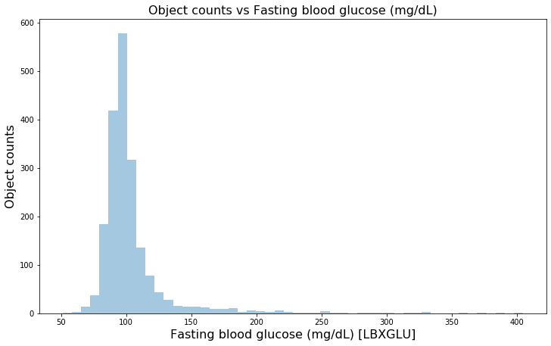
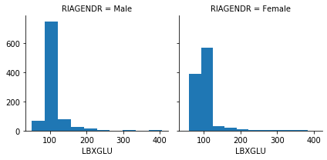
Exploratory data analysis fasting blood glucose
Group | Fasting blood glucose (mg/dL) | High fasting blood glucose Classification
Normal | <100 | No
Pre-diabetes | 100-125 | Yes
Diabetes | >126
count | 1973
mean | 104.2
std | 30.6
min | 51
25% | 91
50% | 97
75% | 105
max | 405

Slide 9
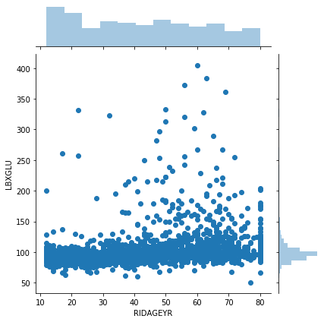
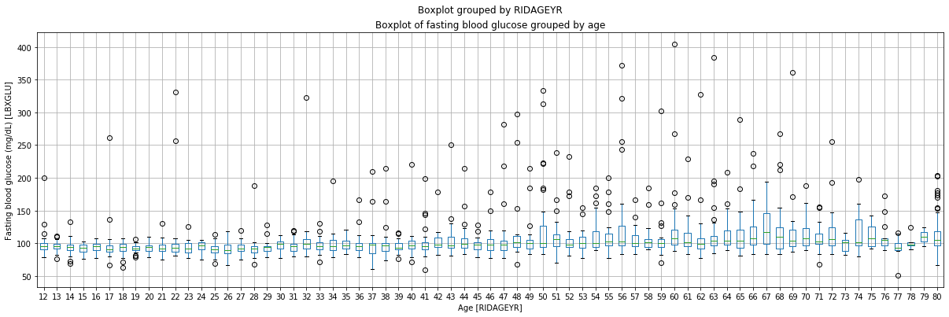
Exploratory data analysis fasting blood glucose vs. Age
Fasting blood glucose (mg/dL)
Mean < 100
Mean > 100
Age

Slide 10
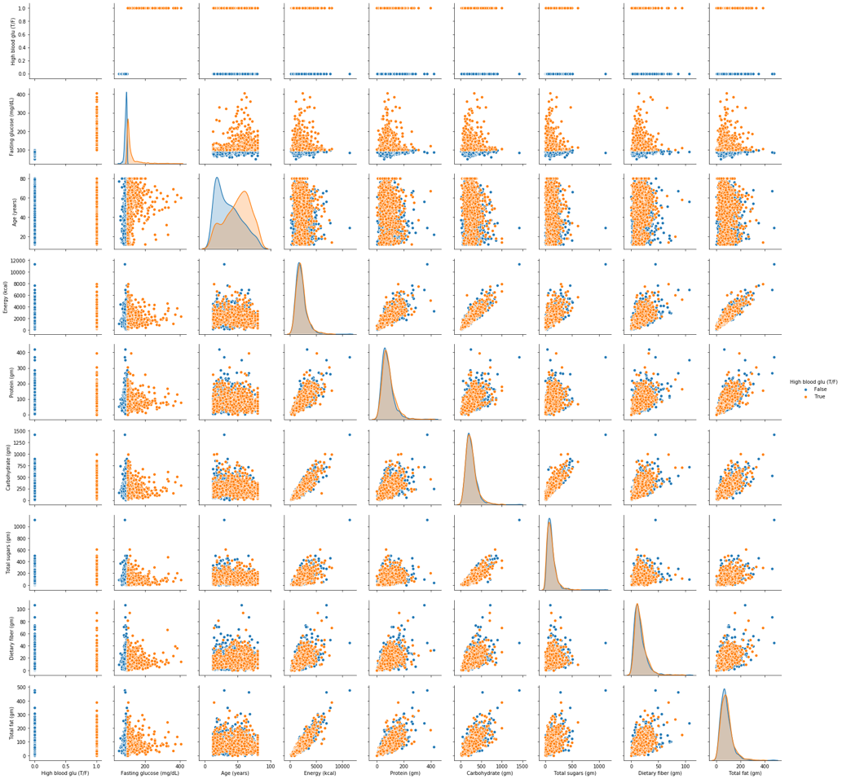
Exploratory data analysis Key features

Slide 11
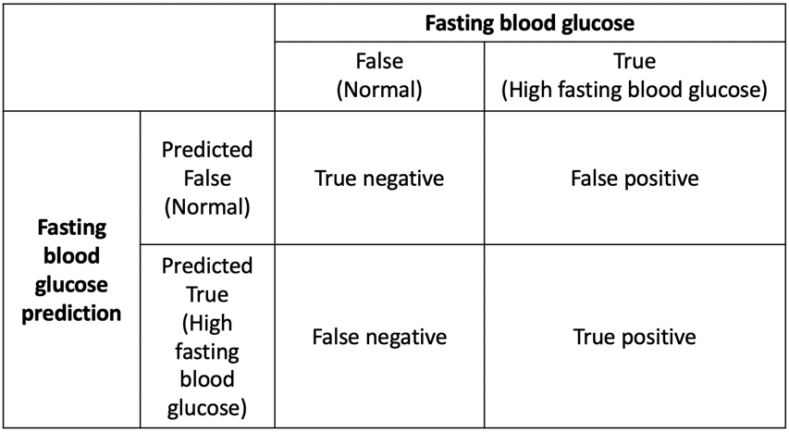
Machine learning: Classification model
Scoring: Recall
As a
Random Forest
Logistic regression
Support vector machine
K-nearest neighbors
AdaBoost
Gradient tree boosting
Voting classifier

Slide 12
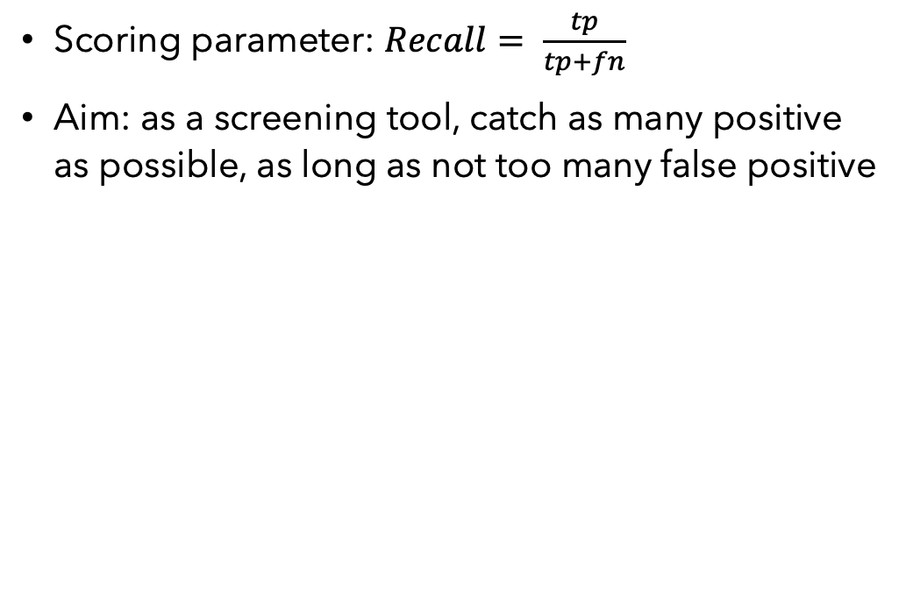
Machine learning: Classification models
Random Forest
Logistic regression
Support vector machine
K-nearest neighbors
AdaBoost
Gradient tree boosting
Voting classifier
(Scikit-learn)
Scoring parameter: $Recall= \frac{tp}{tp+fn}$
Aim: as a screening tool, catch as many positive as possible, as long as not too many false positive

Slide 13
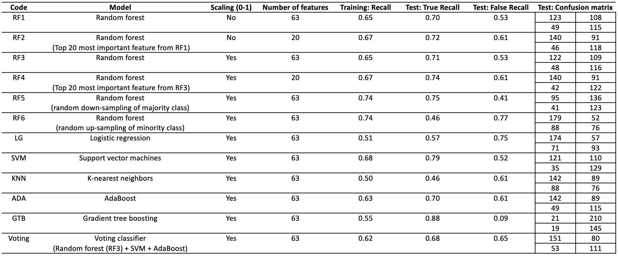
ML: Classification models

Slide 14
ML: Classification models

Slide 15
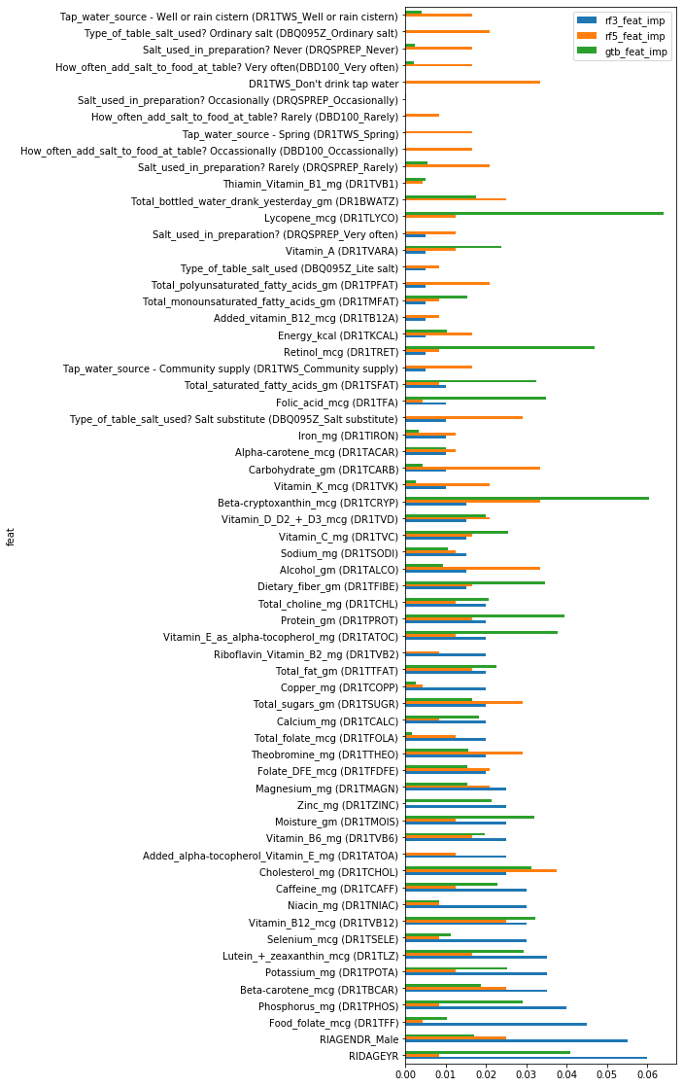
Feature importance

Slide 16
Important features

Slide 17
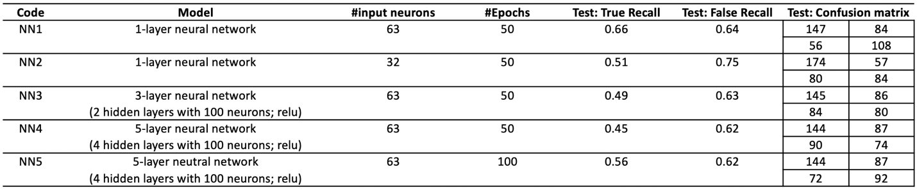
Deep learning: Neural network models
Keras/TensorFlow

Slide 18
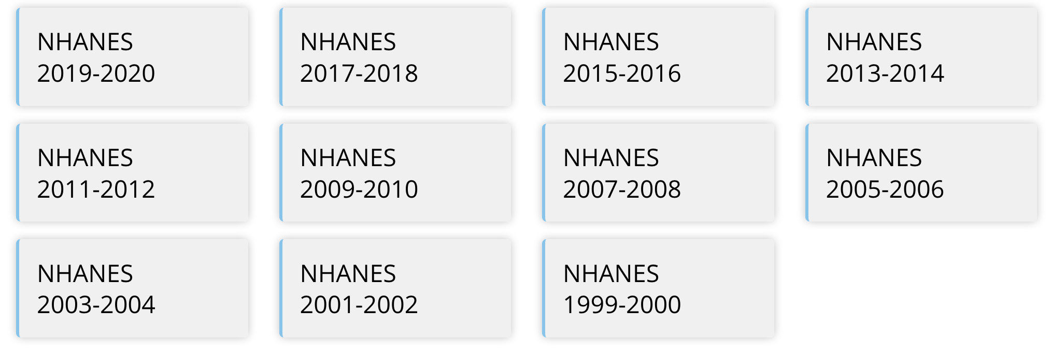
Next
Beyond diet, whare are we missing?
Expanding features from NHANES, such as lifestyle, socioeconomic, health, medication data, etc.
More data!
Expand data set with NHANES data from 1999 to present

Slide 19
Summary
Developed classification models to predict high fasting blood glucose level based on one’s diet/age/gender – a potential virtual screening tool for type 2 diabetes
Best models (Recall >0.7):
Random forest
SVM
AdaBoost

